Slide 1

PROJECT MEMBERS
BARATH.R 234011101057
BARRY JUDE MANUEL 234011101058
BASKAR.D.A 234011101059
BHARATH.R 234011101060
M s . S .Srividhya Santhi
Project coordinator

Slide 2
PriceWatch
Real Estate Price Prediction & Market Analysis

Slide 3
Abstract
Price Watch is a real estate price prediction system that helps users know the fair value of a property. Property prices change based on location, size, and market demand, which often creates confusion for buyers and sellers.
This system uses machine learning to analyze past data and predict accurate property prices.
Users can enter property details to get instant price predictions, view price trends, and compare similar properties, helping them make better and informed decisions.

Slide 4
Existing System
In the existing system, buyers and sellers mainly rely on real estate websites and agents that display only the listed property prices.
These prices are often set by sellers and may not match the actual market value. Users do not get price predictions based on data or market trends.
Comparing similar properties in different areas is also difficult, which can lead to confusion and poor decision-making.

Slide 5
Disadvantages (existing system)
• Property prices may be higher or lower than the actual value • No system to predict the correct price of a house • Users cannot easily check which area is cheaper or better • No guidance on when to buy or sell property • Decision-making becomes confusing for buyers and sellers

Slide 6
Proposed System
The proposed system, PriceWatch, helps users find the correct value of a property easily.
Users enter basic property details like location, size, and number of rooms.The system uses machine learning to analyze past data and predict the fair price.
It also shows price trends and compares similar properties. This helps users make clear and confident decisions when buying or selling property.

Slide 7
Advantages (proposed system)
• Predicts correct property value using data
• Helps users understand market conditions
• Makes property comparison simple
• Reduces risk of overpaying or underpricing
• Improves confidence in buy and sell decisions

Slide 8
Hardware requirement
• Laptop or Desktop Computer • Processor: Intel Core i3 or above • RAM: Minimum 8 GB • Storage: Minimum 256 GB SSD or HDD • Internet Connection for data access and updates

Slide 9
Software Requirement
• Operating System: Windows 10 or above / Linux / macOS • Frontend: React.js • Backend: Node.js with Express • Database: MongoDB • Machine Learning: Python with Scikit-learn • Data Visualization: Chart.js • Others: Web browser (Chrome, Edge, or Firefox), CSV/Image file support

Slide 10
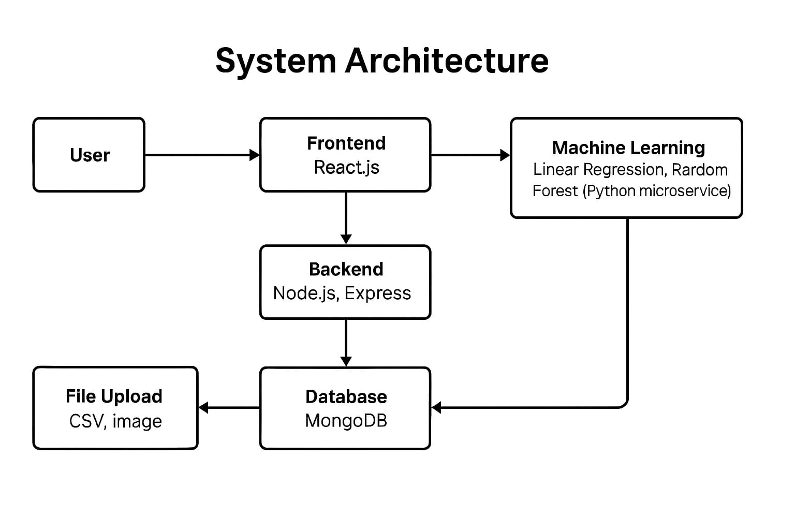

Slide 11
Module Description
User Module – Allows users to register, login, and enter property details.
Price Prediction Module – Uses machine learning to predict the fair value of a property.
Comparison Module – Compares similar properties and shows the best value options.
Market Analysis Module – Displays price trends and area-wise analysis for better decisions.

Slide 12
Feasibility Study
Technical Feasibility – The project uses widely available technologies like React.js, Node.js, MongoDB, and Python for machine learning, making it easy to implement.
Economic Feasibility – Requires minimal hardware and free/open-source software, so the project can be developed at low cost.
Operational Feasibility – Simple user interface allows users to easily enter property details and get price predictions without technical knowledge.
Schedule Feasibility – The system can be developed and tested within a limited time using existing tools and frameworks.

Slide 13
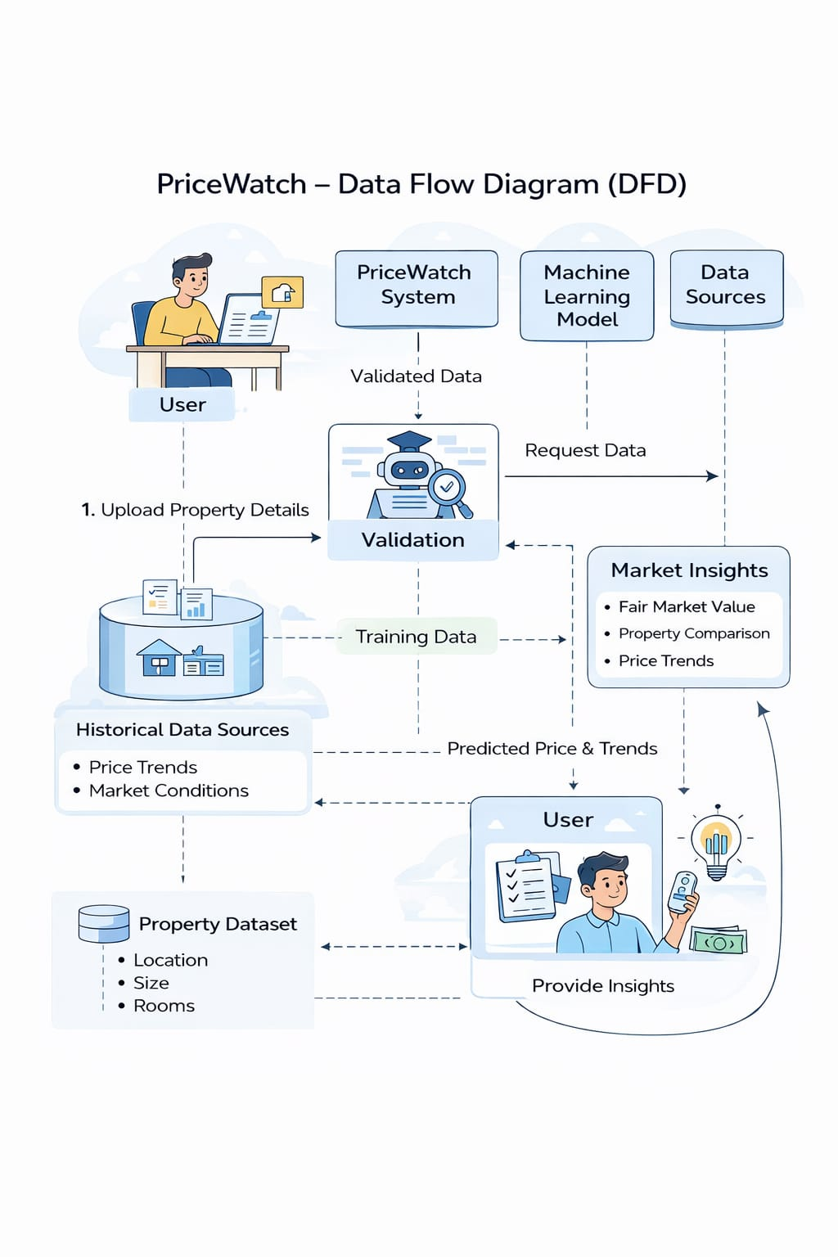
Data Flow Diagram (explanation)
User uploads property details (location, size, rooms).
System validates the uploaded data to ensure correctness.
System requests historical data (past prices, market trends) from data sources.
Validated and historical data is used to train the machine learning model.
Machine learning predicts property prices and future trends.
System generates market insights: fair market value, property comparisons, price trends.
User receives insights and recommendations to make informed decisions.

Slide 14
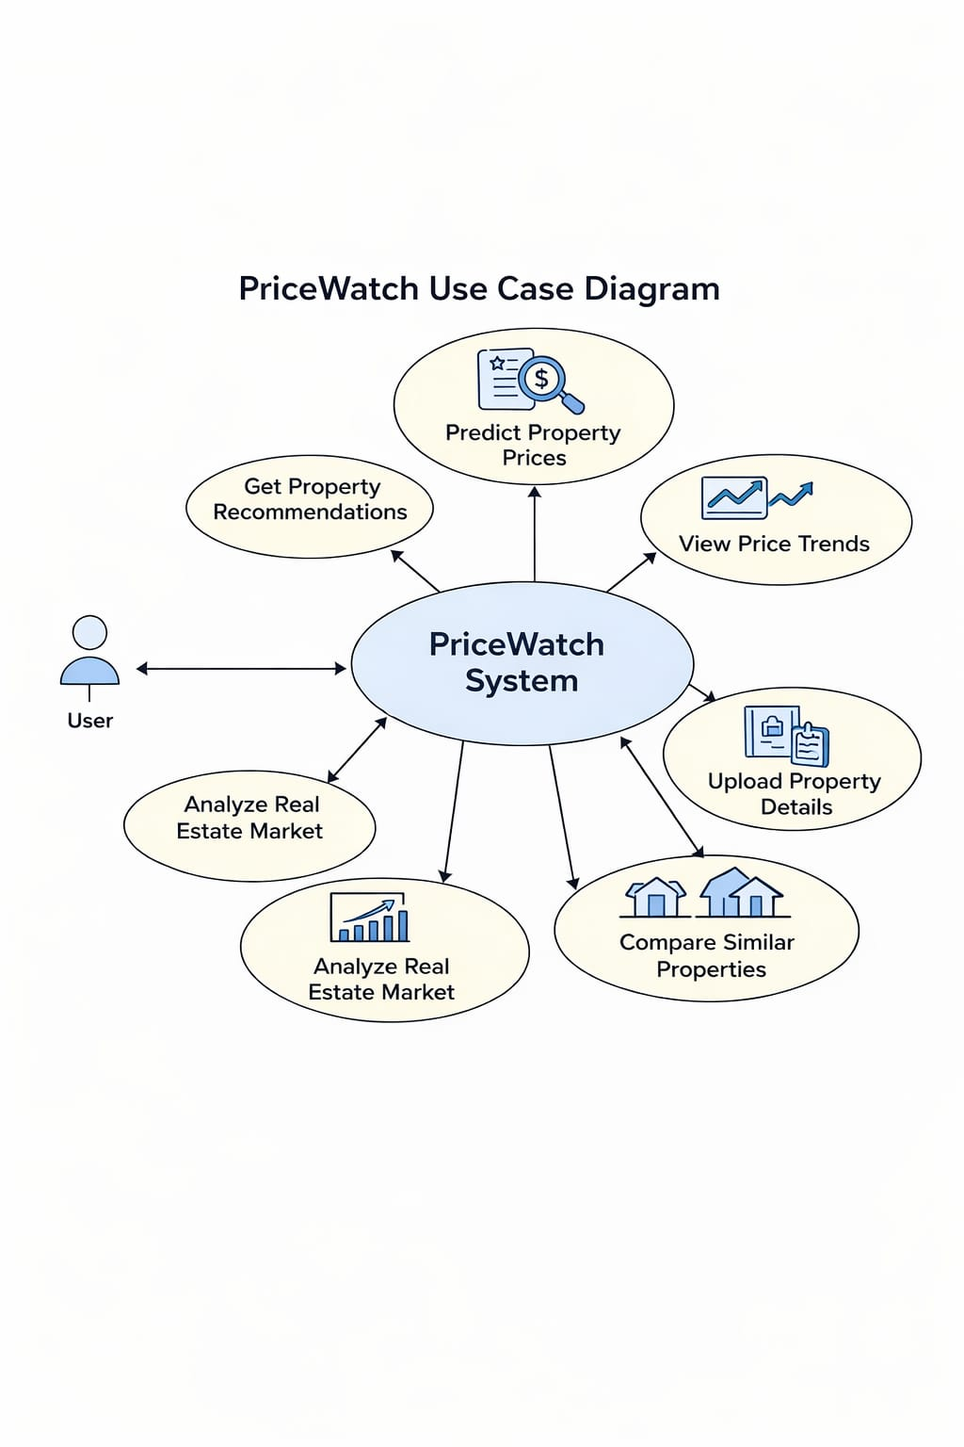
PriceWatch Use Case (explaintaion)
User Login/Signup – The user logs in or creates an account to use the system.
Upload Property Details – The user enters property information like location, size, and rooms.
Validate Property Data – The system checks if the entered details are correct and complete.
Analyze Data – The system uses historical data and machine learning to predict property prices.
View Predictions – The user can see predicted prices and trends for their property.
Compare Properties – The user can compare different properties and their prices.
Get Recommendations – The system suggests buying, selling, or fair pricing advice.

Slide 15
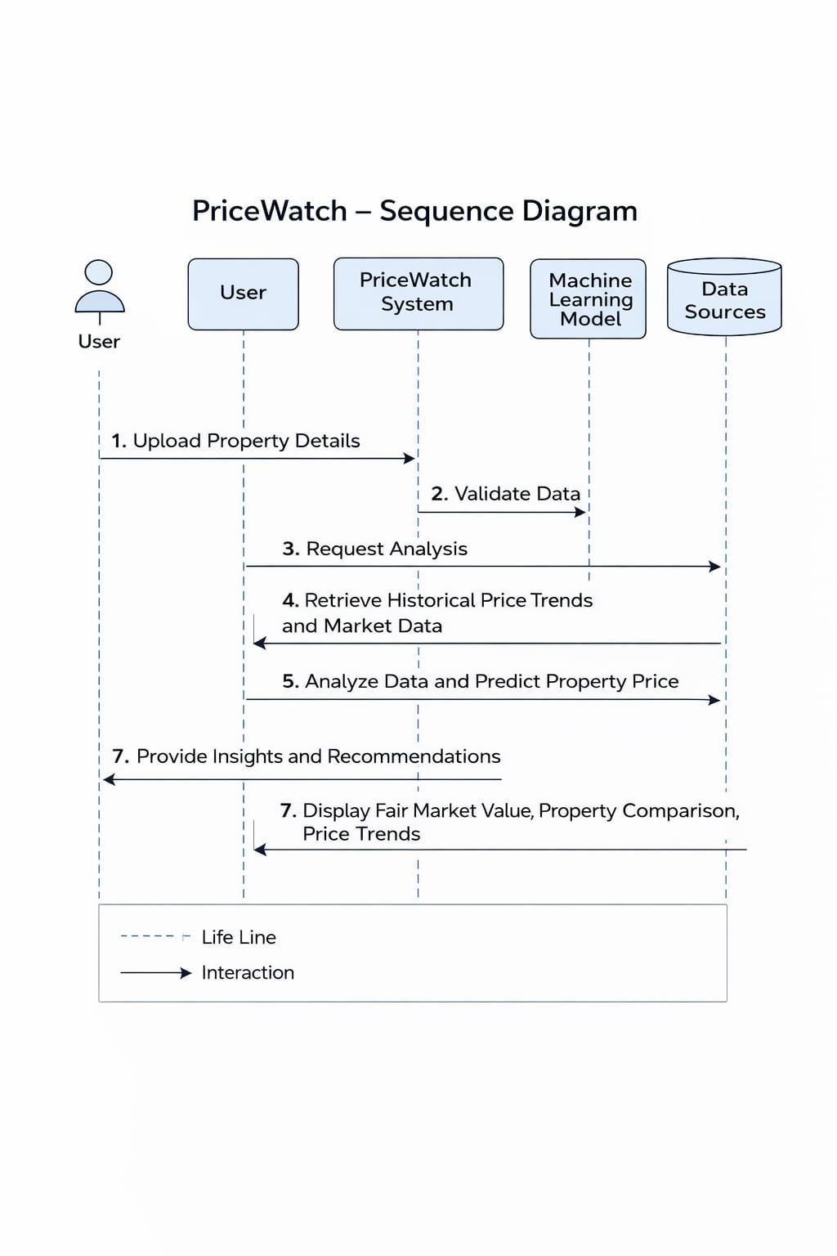
PriceWatch Sequence Diagram (explanation)
User enters property details – The process starts when the user submits property info like location, size, and rooms.
System validates data – The system checks the details for correctness and completeness.
System requests historical data – The system fetches past property prices and market trends.
Machine Learning processes data – The validated data and historical data are analyzed to predict prices and trends.
System generates insights – The system prepares predictions, comparisons, and recommendations.
User receives results – Predicted prices, property comparisons, and recommendations are displayed to the user.

